Slide 1










Bad Method
Knorr-Bremse Production Systems
Problem
Do not get all the facts
Problem Returns
Jump to Solution
_{(deploy} Mater s Methods _{asure)}
co^{ia}u^{l} nterm | e
 | Insert Revised Problem Statement Here.
Problem
Man
Machine
│1

Slide 2
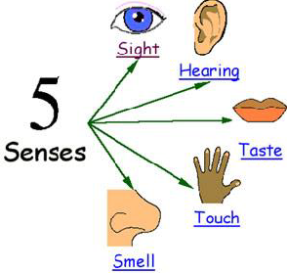

Lean Method
Knorr-Bremse Production Systems
5G Principle
5 Why
5W1H
Fishbone Diagrams
Materials Methods
Problem
Insert Revised Problem
Statement Here.
Man
Machine
│2

Slide 3
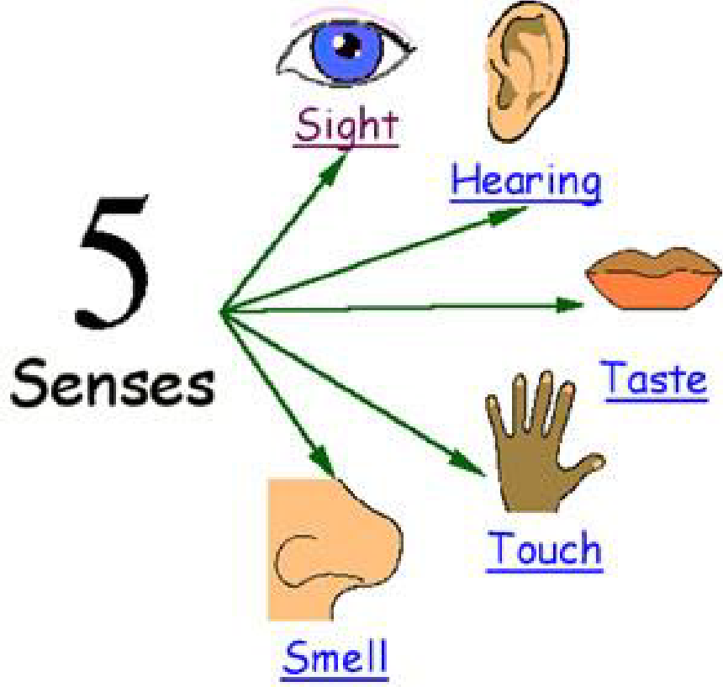
5G Principle:
Knorr-Bremse Production Systems
5G Principle – 1st 3 G’s:
Actual Place
Go to the spot
(GEMBA)
Actual Things
Examine the objects (GEMBUTSU)
Actual Facts
Check facts and figures (GENJITSU)
│3

Slide 4


5G Principle:
Knorr-Bremse Production Systems
5G Principle – Last 2 G’s:
Principles
Refer to the proper tools / methods (GENRI)
Standards & parameters
Follow the standard (GENSOKU)
Goal: Restores conditions to the Standard
│4

Slide 5
5W 1 H:
Knorr-Bremse Production Systems
What is 5W1H?
Questioning technique
That provides the full story of a problem
Asking: What, When, Where, Who, Which and How
│5

Slide 6
5W 1 H:
Knorr-Bremse Production Systems
When do we use 5W1H?
To define a problem/problem statement
A problem well stated is a problem half solved……
│6

Slide 7
5W 1 H:
Knorr-Bremse Production Systems
5W1H – How to do it – Step 1
Write down your problem statement (top section)
5W1H - Define the problem
Initial Problem Statement

Slide 8
5W 1 H:
Knorr-Bremse Production Systems
5W1H – How to do it – Step 2
Answer the questions in the boxes at the right
(top section)
Is / Is not Don’t Forget to Ask Both!
What | What does the issue look like? What product, machine, material was being used? What size? What are the boundaries of the problem? Examples to consider: organizational, workflow, geographic, customer segments, etc. What is the issue causing? What will happen when it is fixed? What will happen if we don’t solve the problem?
When | When did the issue occur? When in the sequence of operation; startup, continuous running, intermittent problem, shutdown, changeover? When does it need to be fixed?
Where | Where did you see the issue or where does it occur? Is it only in certain locations, processes, products, etc.? Where on the equipment or material did you see the issue?
Who | Everyone? Or Specific groups, organizations, customers, etc.? If it is it less of a problem for some individuals or teams, what info can they offer? Is it specific to a certain shift? Is it skill related?
Which | Which trend or pattern does the abnormality have? e.g. Is the abnormality more frequent on Monday mornings? After a change-over? Or is it random in nature? Which direction does the abnormality happen in? (Note: Not many abnormality are truly random!)
How | How is the state of the equipment changed from the optimal? How many times does the problem occur? How many parts are involved? How are you going to solve the problem? Using what method or techniques?

Slide 9
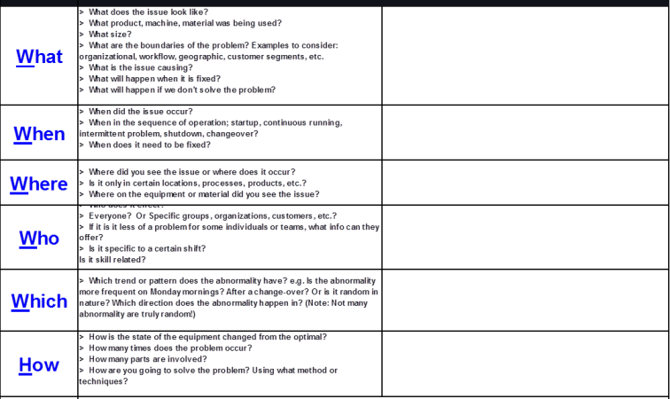
5W 1 H:
Knorr-Bremse Production Systems
5W1H – How to do it – Step 3
Rewrite your problem statement using the answers you wrote at the right of the questions
Make sure you can take action!!
Revised Problem Statement

Slide 10
Fishbone What is a Fishbone Diagram?
Materials Methods
Problem
Insert Revised Problem
Statement Here.
Revised Problem Statements are Developed using 5W 1H.
Man
Machine
A member of the Knorr-Bremse Group
©Bendix Commercial Vehicle Systems LLC • All Rights Reserved • Bendix Confidential
│10

Slide 11
Fishbone
Knorr-Bremse Production Systems
What is a Fishbone Diagram?
Materials
Methods
Visual problem solving tool
Problem
Insert Revised Problem
Statement Here.
Provides a way to understand potential causes
Man
Machine
of an abnormality
A member of the Knorr-Bremse Group
©Bendix Commercial Vehicle Systems LLC • All Rights Reserved • Bendix Confidential

Slide 12

Fishbone
Knorr-Bremse Production Systems
Why use a Fishbone Diagram
To reach the root cause of an abnormality
Problem/Effect
Root Cause
To display and identify possible causes of a
problem

Slide 13
Fishbone
Knorr-Bremse Production Systems
How to complete a Fishbone Diagram
Revised Problem
Write the abnormality in the right hand box
Write the 4 categories in the other boxes
Statements are Developed using 5W 1H.
Manpower (Man, Personnel)
Machine
Material
Methods
Materials
Methods
For each category, list the relevant causes
Focus on one category at a time.
Circle the most probable root causes for 5 Why analysis
Problem
Insert Revised Problem
Statement Here.
Man
Machine

Slide 14
5 Why
Knorr-Bremse Production Systems
What is a 5Why Analysis?
A method of analyzing cause & effect
A problem solving tool used to reach the root cause of a problem
The method involves asking "Why … ?" five times
│14

Slide 15


5 Why
Knorr-Bremse Production Systems
Reasons to use a 5 Why Analysis
To understand the real root cause(s) of a problem
To reach solutions that treat the root cause and not the symptoms
│15

Slide 16
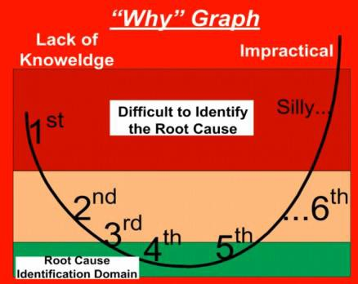
5 Why
Knorr-Bremse Production Systems
5Why Guidelines
Stop at last why where you can
do something.

Slide 17

5 Why
Knorr-Bremse Production Systems
How to conduct a 5 Why Analysis
Define and write down the Problem
Ask ”Why” the problem happened and write down the answer
If the answer is not a action that solves the problem, Ask Why the answer
happened and write down the answer
Repeat Step 3 until you have a action that solves the problem has been
identified.
  May take more or less than 5 Whys.
  Keep asking until you can no longer answer or you can no longer action the answer.

Slide 18
5 Why
Knorr-Bremse Production Systems
5 Why Analysis - Finding the Real Root Cause
Repeat the “Why” search again and again.
The real root cause becomes apparent at this point.
Problem
1st cause
Why?
2nd cause
Why?
3th cause
Why?
4th cause
Why?
If you make a Solution (Countermeasure) at this point, the problem will reoccur, because the Real Root Cause wasn’t found until the 5th Why…
Real Root Cause
Why?
Based on the Real Root Cause, Select a
SMART Target…
Specific Measureable Achievable Realistic Timed

Slide 19
5 Why
Knorr-Bremse Production Systems
MACHINING EXAMPLE: 5Why Analysis
Effect
Potential causes
Action
1-Why 2-Why 3-Why 4-Why
5-Why
Can’t Edit Programs at Machine
Insufficient Memory on Computer
Many Programs Located on Leader’s Computer
Add PC to Machinist’s Booth
Tooling Shortage
Existing Tools Are Worn Out
No Stable Process to Repair or Replace Tools
Lack of Dedicated Person to Take Care of Tools
No Budget for Add’l Personnel
Move Tool Resp. to Tool Crib
in Bay 2
Problems with Parts
Wrong Parts are Delivered
BOM is Incorrect
Last Minute Changes to Parts not Communicated
Revise BOM Process
The 2 or 3 Most Likely Potential Root Causes from the Fishbone Analysis
The REAL Root
Causes
Actions to Correct
the Issue

Slide 20
5 Why
Knorr-Bremse Production Systems
5Why Guidelines
Use short and simple phrases
Be as precise as possible, avoid general expressions
Try to quantify
Do not stop if you can ask “why” another time
A root cause has been found if you can put an action on it that will
elimiate the abnormality
The analysis should be supported by real facts and figures
Do small logical steps

Slide 21
5 Why
Knorr-Bremse Production Systems
Summary
The 5 Why Analysis is a problem solving tool used to reach root causes.
Use a 5 Why Analysis to:
  Reach the root cause of a problem.
Remember the general guidelines for 5 Why Analysis.
Don’t jump to conclusions or assume the answer is obvious.
Be objective.
Focus on systems and processes, not people
Ask “Why” until the root cause is uncovered
Path should make sense when read in reverse using “therefore”
How to conduct the 5 Why Analysis.
  Write down the problem
  Ask ”Why” the problem happened and write down the answer.
  Repeat until the Root Cause has been identified.
    May take more or less than 5 Whys.
    Keep asking until you can no longer answer

Slide 22
5G Principle
Knorr-Bremse Production Systems
5 Why
5W1H
Fishbone Diagrams
Materials Methods
Problem
Insert Revised Problem
Statement Here.
Man
Machine

Slide 23
Appendix
Knorr-Bremse Production Systems

Slide 24

5W 1 H:
5W1H - Define the problem
Initial Problem Statement |  |  | Is / Is Not
What | What does the issue look like? What product, machine, material was being used? What size? What are the boundaries of the problem? Examples to consider: organizational, workflow, geographic, customer segments, etc. What is the issue causing? What will happen when it is fixed? What will happen if we don’t solve the problem?
When | When did the issue occur? When in the sequence of operation; startup, continuous running, intermittent problem, shutdown, changeover? When does it need to be fixed?
Where | Where did you see the issue or where does it occur? Is it only in certain locations, processes, products, etc.? Where on the equipment or material did you see the issue?
Who | Who does it effect? Everyone? Or Specific groups, organizations, customers, etc.? If it is it less of a problem for some individuals or teams, what info can they offer? Is it specific to a certain shift? Is it skill related?
Which | Which trend or pattern does the abnormality have? e.g. Is the abnormality more frequent on Monday mornings? After a change-over? Or is it random in nature? Which direction does the abnormality happen in? (Note: Not many abnormality are truly random!)
How | How is the state of the equipment changed from the optimal? How many times does the problem occur? How many parts are involved? How are you going to solve the problem? Using what method or techniques?
Revised Problem Statement
5W1H Form
A member of the Knorr-Bremse Group
©Bendix Commercial Vehicle Systems LLC • All Rights Reserved • Bendix Confidential

Slide 25
5 Why
5 Why form:
Effect | Potential Causes |  |  |  |  | Action
 | 1-Why | 2-Why | 3-Why | 4-Why | 5-Why
A member of the Knorr-Bremse Group
©Bendix Commercial Vehicle Systems LLC • All Rights Reserved • Bendix Confidential

