Slide 1

Food Safety and Sanitation Guidelines

Slide 2
Copyright
Copyright © Texas Education Agency, 2012. These Materials are copyrighted © and trademarked ™ as the property of the Texas Education Agency (TEA) and may not be reproduced without the express written permission of TEA, except under the following conditions:
1) Texas public school districts, charter schools, and Education Service Centers may reproduce and use copies of the Materials and Related Materials for the districts’ and schools’ educational use without obtaining permission from TEA.
2) Residents of the state of Texas may reproduce and use copies of the Materials and Related Materials for individual personal use only, without obtaining written permission of TEA.
3) Any portion reproduced must be reproduced in its entirety and remain unedited, unaltered and unchanged in any way.
4) No monetary charge can be made for the reproduced materials or any document containing them; however, a reasonable charge to cover only the cost of reproduction and distribution may be charged.
Private entities or persons located in Texas that are not Texas public school districts, Texas Education Service Centers, or Texas charter schools or any entity, whether public or private, educational or non-educational, located outside the state of Texas MUST obtain written approval from TEA and will be required to enter into a license agreement that may involve the payment of a licensing fee or a royalty.
For information contact: Office of Copyrights, Trademarks, License Agreements, and Royalties, Texas Education Agency, 1701 N. Congress Ave., Austin, TX 78701-1494; phone 512-463-7004; email: copyrights@tea.state.tx.us.

Slide 3
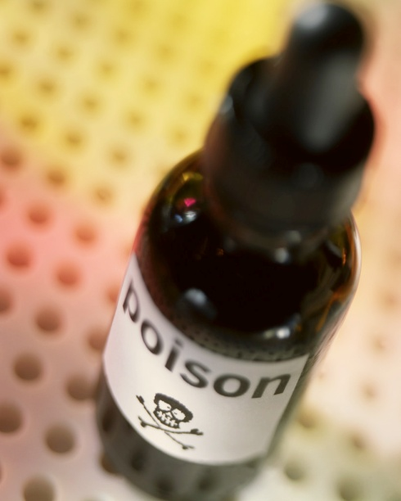

Kitchen Safety

Slide 4
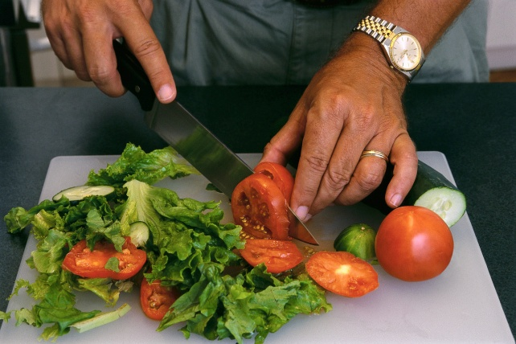

Kitchen Hazards
Burns
Cuts
Electrical shocks
Falls
Poisoning
Notes:
Kitchens are the gathering place for many families. As parents are cooking, children are working on their homework, helping with the chores, and sharing their day. There are five main hazards that can occur in the kitchen.
Burns – prevent by keeping the kitchen clean
Cuts – prevent by handling and washing knives, graters, and other sharp-edged tools carefully
Electrical shocks – prevent by handling cords, appliances, and chemicals carefully
Falls – prevent by removing hazards that could cause slips and trips
Poisoning – prevent by storing all household chemicals away from food and out of children’s reach
Deaths from fires and burns are the third leading cause of fatal home injury
Falls are the leading cause of non-fatal injuries for all children ages 0 to 19. Every day, approximately 8,000 children are treated in U.S. emergency rooms for fall-related injuries
Every day, nearly 82 people die as a result of unintentional poisoning; another 1,941 are treated in emergency departments
Content source: Centers for Disease Control and Prevention
National Center for Injury Prevention and Control

Slide 5
Safety Guidelines
Pay attention to tasks
Dress for safety
Prevent clutter
Close drawers and doors completely
Use the right tool for the right job
Store heavy items on low shelves
Be aware of exit route
Notes:
Just a few seconds of carelessness can turn the kitchen into an accident waiting to happen.
Focus on what you are doing especially when cutting, cooking or using appliances.
Wear short or snug sleeves and tie back long hair and apron strings.
Put items back where they belong as soon as you finish them to control clutter.
Make sure cabinet doors and drawers are closed completely to avoid bumps and bruises.
Always use kitchen utensils safely and use the right tool for the job.
Store large pots and heavy items on low shelves to prevent them falling on you.
Know how to evacuate the room if needed.

Slide 6
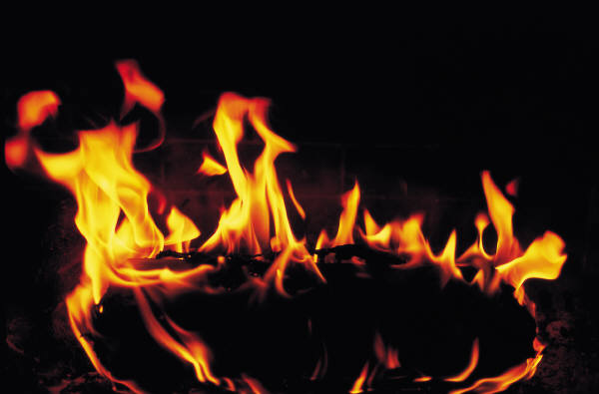
Fire Safety
Kitchen Fire 411
(Click on link)
Notes:
View video on how quickly a kitchen fire can spread and then how to use a fire extinguisher. Have students locate the fire extinguisher in your classroom.
Click on hyperlink:
Kitchen Fire 411
Uploaded by CBS
Susan Koeppen visits a fire testing facility to show you how to deal with a grease fire in your kitchen quickly and safely.
http://youtu.be/PyrbiU0sB4s

Slide 7
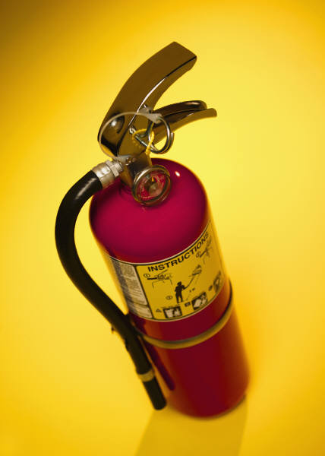
Fire Extinguisher
How to Use a Fire Extinguisher
  Know how fire extinguishers are classified
  Inspect the fire extinguisher
  Decide if you will evacuate or stay and fight
  Remember the acronym PASS
    Pull the pin
    Aim at the base of the fire Squeeze the lever
    Sweep back and forth
    How to Use a Fire Extinguisher
    (Click on link)
Notes:
Accidents happen. Be prepared to fight your own fire by learning how to use a fire extinguisher.
Click on hyperlink:
How to Use a Fire Extinguisher
Howcast video
http://youtu.be/lUojO1HvC8c
You Will Need
Courage
Calm
Fire extinguisher
Step 1: Know how fire extinguishers are classified
Know how fire extinguishers are classified. Class A extinguishers are for common combustibles like paper or wood; Class B are for flammable liquids; and Class C are for electrical fires.
The Red Cross recommends ABC classified fire extinguishers for home use.
Step 2: Inspect the fire extinguisher
Inspect the fire extinguisher before use. Read instructions and warnings; check that the pressure gauge needle is in the green portion of the gauge; and check for a clogged nozzle, a broken seal, or other damage.
A fire extinguisher won’t work if it’s not properly charged. The pressure gauge measures the charge.
Step 3: Decide if you'll evacuate or stay and fight
Decide if you’ll evacuate or stay and fight the fire. Consider the size of the fire, the amount of smoke in the room, and whether there is a reliable escape route.
Step 4: Remember the acronym PASS
Remember the acronym PASS. It stands for Pull, Aim, Squeeze, and Sweep.
Step 5: Pull the pin that unlocks the operating handle
Pull the pin or ring that unlocks the fire extinguisher’s operating handle, and aim the extinguisher at the base of the fire.
Aim at the fire from 6 to 8 feet away.
Step 6: Squeeze extinguisher lever to discharge contents
Squeeze the extinguisher lever to discharge its contents, and sweep the hose back and forth until the extinguisher is empty.
Food Network star Alton Brown used a carbon dioxide fire extinguisher, a water cooler bottle, and a tennis racket to make a fruit smoothie on television.

Slide 8
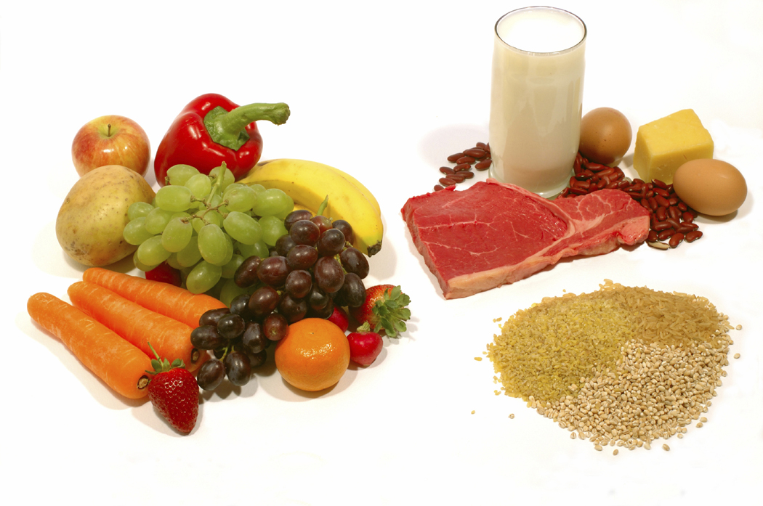
Food Safety

Slide 9
Foodborne Illness
Each year, 1 in 6 Americans (or 48 million people) get sick from and 3,000 die of foodborne diseases.
Reducing foodborne illness by just 10% would keep 5 million Americans from getting sick each year.
FoodSafety.gov
Notes:
The illness may be mild, lasting just a day or two, or even severe enough to require hospitalization. In some cases it can even result in death.

Slide 10

Causes of Food Poisoning
Bacteria and Viruses
Parasites
Mold, Toxins, and Contaminants
Allergens
Notes:
Bacteria and Viruses
Bacteria and viruses are the most common cause of food poisoning. The symptoms and severity of food poisoning vary, depending on which bacteria or virus has contaminated the food.
Parasites
Parasites are organisms that derive nourishment and protection from other living organisms known as hosts. In the United States, the most common foodborne parasites are protozoa, roundworms, and tapeworms.
Mold, Toxins, and Contaminants
Most food poisoning is caused by bacteria, viruses, and parasites rather than toxic substances in the food. But, some cases of food poisoning can be linked to either natural toxins or chemical toxins.
Allergens
Food allergy is an abnormal response to a food triggered by your body's immune system. Some foods, such as nuts, milk, eggs, or seafood can cause allergic reactions in people with food allergies.

Slide 11
Long Term Effects
Kidney failure
Chronic arthritis
Brain and nerve damage
Death
Notes:
Kidney failure
Hemolytic-uremic syndrome (HUS) is a serious illness that usually occurs when an infection in the digestive system produces toxic substances that destroy red blood cells, causing kidney injury. HUS may occur after infection with some kinds of E. coli bacteria.
HUS is most common in children. In fact, it is the most common cause of acute kidney failure in children.
Chronic arthritis
A small number of persons with Shigella or Salmonella infection develop pain in their joints, irritation of the eyes, and painful urination. This is called reactive arthritis. It can last for months or years, and can lead to chronic arthritis, which is difficult to treat. Persons with Campylobacter infections may also develop chronic arthritis.
Brain and nerve damage
A Listeria infection can lead to meningitis, an inflammation of the membranes surrounding the brain. If a newborn infant is infected with Listeria, long-term consequences may include mental retardation, seizures, paralysis, blindness, or deafness.
Guillain-Barré syndrome is a disorder that affects the nerves of the body. This occurs when a person's immune system attacks the body's own nerves. It can result in paralysis that lasts several weeks and usually requires intensive care. As many as 40 percent of Guillain-Barré syndrome cases in this country may be triggered by an infection with Campylobacter.
Death
In the United States, approximately 3,000 people die each year of illnesses associated with food poisoning. Five types of organisms account for 88 percent of the deaths for which the cause is known: Salmonella, Toxoplasma, Listeria, norovirus, and Campylobacter.
Other types of foodborne illness may cause death as well. For example, some Vibrio infections (usually associated with eating raw shellfish) may infect the bloodstream and cause a severe, life-threatening illness. About half of these infections are fatal, and death can occur within two days.

Slide 12


Who’s at Risk?
Older adults
Very young children
Persons with chronic illnesses
Notes:
Older Adults
As we age, our immune system and other organs in our bodies become less effective in recognizing and ridding the body of microorganisms that cause foodborne illness. If an older person contracts a foodborne illness, there is a great chance of that the effects will be serious or even deadly.
Very Young Children
Small children have not built up strong immune systems and are therefore more likely to become ill.
Persons with Chronic Illnesses
If you have a chronic illness such as AIDS, cancer, or diabetes, the illness and sometimes its treatments can weaken your immune system. Similarly, if you are a transplant recipient, you take drugs to prevent your body from rejecting the new organ. These drugs also prevent your immune system from attacking dangerous microorganisms in food.
Pregnant Women
Women who are pregnant are not specifically spelled out by the FDA and are therefore not listed at risk but should take precautions as their immune system is weakened, which makes it harder to fight off harmful microorganisms in food. At the same time, an unborn baby's immune system is not developed enough to fight off dangerous bacteria. In addition, certain toxins in food, such as mercury, can damage an unborn baby’s developing nervous system.

Slide 13
Cleaning and Sanitizing
Cleaning removes food and dirt from surface
Sanitizing reduces pathogens on a surface to safe levels
Sanitizing the Kitchen
(Click on link)
Prevents the spread of pathogens to food.
Steps:
Clean the surface
Rinse the surface
Sanitize the surface
Allow the surface to air-dry
Notes:
All surfaces must be cleaned and rinsed. Such as:
Walls
Storage shelves
Garbage containers
Any surface that touches food must be cleaned and sanitized. Such as:
Knives
Stockpots
Cutting boards
Click on link:
Sanitizing the Kitchen
Consumers can protect themselves by preventing the spread of germs by both cleaning and sanitizing surfaces where food is prepared. This video explains how to make sanitizing solution with ingredients most people already have around the house.
http://youtu.be/_9IhS2jv2OM

Slide 14
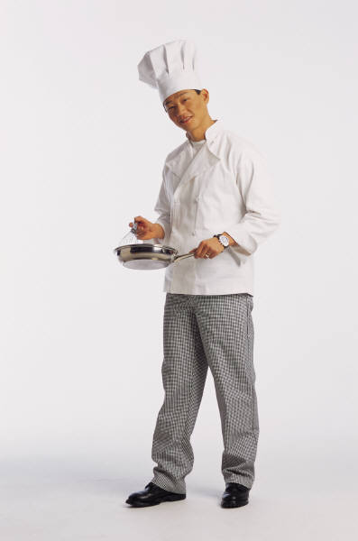
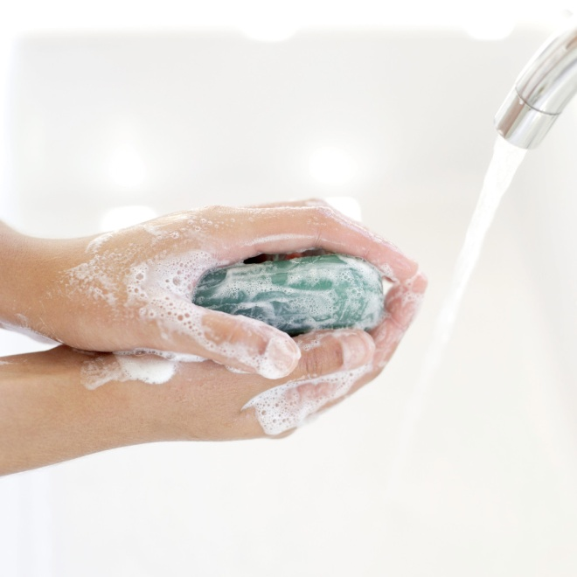
Personal Hygiene

Slide 15

How to Wash Your Hands
Put Your Hands Together
(Click on link)
Wet hands and arms
Apply soap
Scrub hands and arms vigorously
Rinse hands and arms thoroughly
Dry hands and arms
After Washing Your Hands
Use a paper towel to turn off faucet.
Use a paper towel to open restroom door.
Notes:
How to Wash Your Hands
Wet hands and arms
use running water as hot as you can comfortably stand
Apply soap
Apply enough to build up a good lather
Scrub hands and arms vigorously
Scrub them for 10 to 15 seconds
Clean under fingernails and between fingers
Rinse hands and arms thoroughly
Use running water
Dry hands and arms
Do NOT use your apron or any part of your uniform
Use a single-use paper towel or hand dryer
CDC – Centers for Disease Control and Prevention
Put Your Hands Together
http://www.cdc.gov/cdctv/handstogether/

Slide 16
Wash Hands After
Using the restroom
Touching your hair, face, or body
Handling raw meat poultry, or seafood (before and after)
Touching clothing or aprons
Taking out garbage
Sneezing, coughing, or using a tissue
Handling chemicals
Cleaning tables or busing dirty dishes
Eating or drinking
Chewing gum
Handling money
Handling fish or shellfish in a display tank
Before putting on gloves
Touching anything that may contaminate your hands

Slide 17
Appropriate Attire
Wear
Do Not Wear
Clean Aprons
Clean Clothes
Hair restraint
Shoes (slip resistant)
False nails
Fingernail polish
Jewelry
  Watches
  Dangling earrings
  Rings
    Except for a plain metal band
Notes:
Aprons
Should be clean and removed when leaving the food prep areas.
Clothes
Should be clean including chef coats and uniforms.
Hair restraint
Always wear a clean hat or other hair covering while prepping food, working in food prep areas, and the dishwashing area.
Bobby pins may be provided to keep “bangs” from dangling over food prep areas.
Shoes (slip resistant)
Slip resistant shoes are recommended by the Office of Occupational Safety to prevent slips and falls.
Fingernails
Keep fingernails short and clean.
Do not wear false fingernails or nail polish.
Fingernail polish remover may be provided to keep nails clear.
Jewelry
Remove all jewelry from hands and arms including watches, dangling earrings, bracelets and rings except for a plain metal band.

Slide 18

Questions?
Copyright © Texas Education Agency, 2012. All rights reserved.

Slide 19
References and Resources
Images:
Microsoft Office Clip Art: Used with permission from Microsoft.
Textbooks:
Kowtaluk, H. (2010). Food for today. Columbus, OH: Glencoe/McGraw-Hill.
ServSafe® Manager. 6th. Chicago, IL: National Restaurant Association, 2012. Print.
ServSafe Starters Employee Guide™, 5th. Chicago, IL: National Restaurant Association, 2010. Print.
Websites:
Your Gateway to Federal Food Safety Information
www.foodsafety.gov
YouTube™:
How to Use a Fire Extinguisher
Accidents happen. Be prepared to fight your own fire by learning how to use a fire extinguisher.
http://youtu.be/lUojO1HvC8c
Kitchen Fire 411
Susan Koeppen visits a fire testing facility to show you how to deal with a grease fire in your kitchen quickly and safely.
http://youtu.be/PyrbiU0sB4s
Put Your Hands Together
CDC – Centers for Disease Control and Prevention
http://www.cdc.gov/cdctv/handstogether/
Sanitizing the Kitchen
Consumers can protect themselves by preventing the spread of germs by both cleaning and sanitizing surfaces where food is prepared. This video explains how to make sanitizing solution with ingredients most people already have around the house.
http://youtu.be/_9IhS2jv2OM

