Slide 1
LPG SAFETY
Get more training presentation from fjcabagte@gmail.com | +639950276663 | Call | Text | WhatsApp | Viber | Telegram

Slide 2
What is LPG?
LPG SAFETY
LPG (liquefied petroleum gas) generally comes in two common forms:
* BUTANE
* PROPANE
Butane is predominantly used in portable heaters and leisure applications such as barbecues, while propane is predominantly used in domestic heating, commercial cooking, industrial applications, etc.

Slide 3
LPG SAFETY
LPG is usually stored in portable pressurized cylinders, but can be stored in larger quantities using bulk storage tanks. Being pressurized means that any time there is a leak, large quantities of highly flammable gas can be released and is a significant fire hazard.

Slide 4
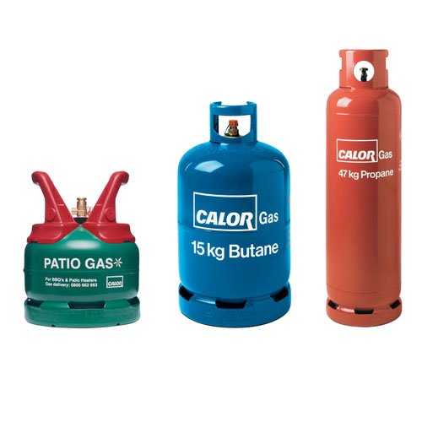
LPG SAFETY
Get more training presentation from fjcabagte@gmail.com | +639950276663 | Call | Text | WhatsApp | Viber | Telegram

Slide 5
LPG - PROPERTIES
LPG SAFETY
LPG is a liquid when pressurized in a cylinder and only becomes a gas when it is released. LPG as a gas is heavier than air, almost two times heavier for butane, and one-and-a-half times for propane. This means that if there is a leak the gas will collect in low points such as in drains and sewers and remain a fire hazard for some time before dispersing.

Slide 6
LPG SAFETY
LPG is non-toxic and generally there are no injurious effects to humans except in large quantities by inhalation. LPG in its natural state is colorless, odorless and tasteless, and so to warn us of a leak the manufacturers add an odorant, which is a harmless chemical and gives LPG its characteristic smell.

Slide 7
LPG SAFETY
LPG is highly flammable and has a very low flash point, −60 °C for butane, and −104 °C for propane, so at normal temperature & air pressure LPG will ignite when exposed to an ignition source. LPG burns with a very high temperature flame, above 1,000 °C for a pre-mixed flame. Moreover, LPG only needs a small quantity of gas in air by volume for flammability to occur, 1.9% to 8.5% for butane, and 2% to 10.3% for propane in air. This means that LPG needs lots of air to support combustion, externally air is readily available, but inside building adequate ventilation must be provided when burning LPG. Without an adequate supply of fresh air incomplete combustion of the LPG will occur and deadly carbon monoxide gas is produced. Carbon monoxide [CO] is a deadly colorless, odorless and tasteless gas known as the ‘silent killer’.

Slide 8
Symptoms of carbon monoxide poisoning
LPG SAFETY
Minor concentrations and exposure…
Shortness of breath
Mild nausea
Mild headaches
Moderate concentrations and exposure…
Headaches
Dizziness
Nausea
Light-headedness
Prolonged and high concentrations can result loss of
consciousness and death!

Slide 9
LPG SAFETY
Treatment options for persons suffering from
carbon monoxide poisoning:
Get the victims into fresh air immediately
Evacuate all persons from the affected house or building
Open all windows and doors
Turn off the LPG using the valve on the cylinder
Call for emergency assistance and get persons affected by carbon monoxide to a hospital as quickly as possible .

Slide 10
LPG – avoiding leaks
LPG SAFETY
Due to the high flammability of LPG, even a minor leak is a serious hazard. This is made worse because humans may not be able to detect the slight odor from a minor LPG leak, but it is vital that any potential leaks are identified and quickly eliminated. But if you smell a strong gas leak you must TURN OFF the supply at the cylinder valve and have it investigated by a qualified and experienced plumber. NEVER use matches, cigarette lighters or any other open flame to search for gas leaks.

Slide 11
LPG SAFETY
But if you suspect you have a minor gas leak, a simple and quick LPG leak detector can be made by adding some soap or washing up detergent liquid to water. Sprinkle the soapy water with a rag or a brush all over the LPG pipework and cylinder valve, and wherever there is a leak large bubbles will form. If you detect a leak no matter how small, IMMEDIATELY TURN OFF the LPG using the valve on the cylinder. Have a qualified and experienced plumber correct the leak before attempting to reuse the LPG equipment. Prevention of leaks is always better than having to deal with a dangerous LPG fire or worse an explosion.

Slide 12
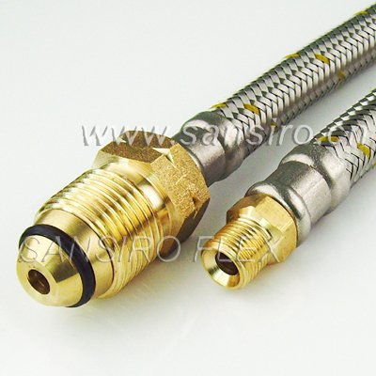
LPG SAFETY
Get more training presentation from fjcabagte@gmail.com | +639950276663 | Call | Text | WhatsApp | Viber | Telegram

Slide 13
Suitable leak prevention measures
LPG SAFETY
Use only purpose made steel-braided synthetic-rubber LPG hoses with threaded couplings and they will last for many years without leaks. Copper pipes can be used but they can be quickly worn out after many repetitive connections and reconnections, and so they are not recommended.

Slide 14
LPG SAFETY
Natural rubber hoses [often pink or light brown color] with ‘jubilee clips’ (adjustable clamps) MUST NEVER BE USED. LPG dries out the natural rubber and eventually it will split or crack causing a leak; and ‘jubilee clips’ or twisted wire can easily work loose or bite into the rubber if they are too tight causing leaks.
If the cylinder valve is broken or the coupling threads are damaged, DO NOT USE and replace with a new cylinder.

Slide 15
LPG SAFETY
LPG is under high pressure in the cylinder, and so the regulator safely reduces the gas pressure before it reaches your LPG appliance. Accordingly, if the regulator is damaged or malfunctioning, high pressure gas may reach your LPG appliance resulting in potential serious injury and fire. If you suspect the regulator is not functioning correctly DO NOT USE and contact your local LPG dealer/vendor to check the regulator and replace it if cannot be properly and safely repaired.

Slide 16
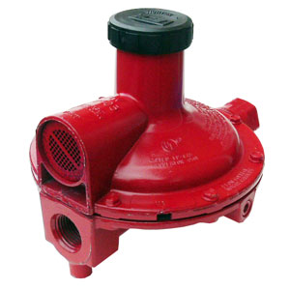
LPG SAFETY
Get more training presentation from fjcabagte@gmail.com | +639950276663 | Call | Text | WhatsApp | Viber | Telegram

Slide 17
LPG SAFETY
LPG can be used for cooking and heating, and so to avoid leaks or accidents it is very important that your LPG appliance is working correctly with no damaged control valves, flame failure devices, burners, etc. Have LPG dealer/vendor or a qualified and experienced plumber check your LPG appliance at least ONCE A YEAR.

Slide 18
LPG SAFETY
If you discover a LPG leak inside a building YOU MUST do the following:
AVOID panicking
TURN OFF all control valves on your LPG appliances (cooking stoves, space heaters, etc)
DO NOT use matches, cigarette lighters or any other open flames to search for gas leaks
DO NOT operate electrical switches
TURN OFF the LPG cylinder valve
EXTINGUISH all open flames in the house (candles, oil lamps, incense sticks, etc)
OPEN all doors and windows
Report the emergency

Slide 19
LPG SAFETY
If you discover a LPG leak outside YOU MUST do the following:
AVOID panicking
TURN OFF all control valves on your LPG appliances (barbecue grills, space heaters, etc)
DO NOT use matches, cigarette lighters or any other open flames to search for gas leaks
TURN OFF the LPG cylinder valve
EXTINGUISH all open flames (candles, oil lamps, incense sticks, etc) within 10-meters (30-ft) of any LPG appliance, pipework or the cylinder
Report the emergency

Slide 20
LPG - cylinders
LPG SAFETY
When full LPG cylinders are heavy, have sharp edges in places and contain liquefied gas under pressure. The main hazards are as follows:
Blast impact from a gas cylinder explosion or rapid release of compressed gas, following a mechanical impact or fire
Impact from parts of LPG cylinders or valves that fail
Fire resulting from the escape of LPG
Impact from falling cylinders, or manual handling injuries

Slide 21
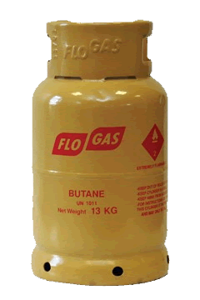
LPG SAFETY
Get more training presentation from fjcabagte@gmail.com | +639950276663 | Call | Text | WhatsApp | Viber | Telegram

Slide 22
The correct procedure for replacing an empty LPG cylinder is as follows:
LPG SAFETY
Removing an empty cylinder…
Turn off all control valves on your LPG appliance
Turn off the valve on the LPG cylinder
Using the correct size wrench, carefully undo the nut on the pipe coupling
Remove the pipe coupling and with your finger check the condition of the synthetic rubber ‘O’ ring seal. If the seal is damaged replace before reusing the coupling
Remove the LPG cylinder

Slide 23
LPG SAFETY
Installing a full cylinder…
Put the LPG cylinder in position and remove the dust cap (if provided)
Carefully reinstall the pipe coupling finger tight making sure the threads are properly aligned, and then tighten the nut on the pipe coupling with the correct size wrench. Do not over tighten or damage the nut
Prepare a mixture of soap or washing up detergent liquid in some water, turn on the LPG cylinder valve fully open, and using a brush or rag cover the nut, regulator and surrounding pipework with the soapy solution. If no large bubbles are observed the LPG appliance is ready to use. However, if bubbles appear there is a gas leak, turn off the cylinder valve and investigate the cause. Repeat the process and if the leak persists, have a qualified and experienced plumber to inspect the problem.

Slide 24
LPG SAFETY
When transporting empty or refilled LPG cylinders, they should be in an upright position and must be securely tied down to ensure they do not roll around and get damaged. Check that the valve is firmly turned off before putting the LPG cylinder into a vehicle, and no smoking during any part of the journey.

Slide 25
LPG SAFETY
Smaller quantities of LPG are available in Camping Gaz (Gas) Cartridges; the hazards are same for the larger cylinders, except the cartridge is constructed from aluminum alloy. This means the cartridge can be more easily punctured by sharp objects and has less resistance to heat during a fire or from strong sunlight.

Slide 26
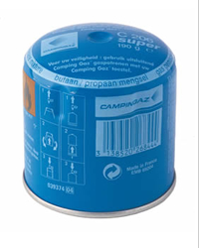
LPG SAFETY
Get more training presentation from fjcabagte@gmail.com | +639950276663 | Call | Text | WhatsApp | Viber | Telegram

Slide 27
LPG SAFETY
LPG can be stored in larger quantities than in a cylinder, such as bulk storage tanks, but the entire installation must be designed, installed and operated in accordance with NFPA 54 [National Fuel Gas Code]. This is beyond the scope of the normal user and this must be handled by an LPG specialist mechanical engineer.

Slide 28
THANK YOU
Get more training presentation from fjcabagte@gmail.com | +639950276663 | Call | Text | WhatsApp | Viber | Telegram

