Slide 1
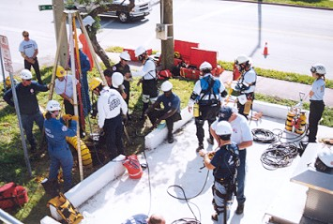
Confined Space Rescue Awareness
An Overview of Confined Space Rescue

